Slide 1
CSE-2218
Data Structure and Algorithms II Lab
Recursion
Lecturer Shekh. Md. Saifur Rahman
United International University
1

Slide 2
Recursion
Recursion is a process in which a function calls itself.
For example:
int fun()
{
…………..
…………..
fun();
}
Note: but the base condition must be added

Slide 3
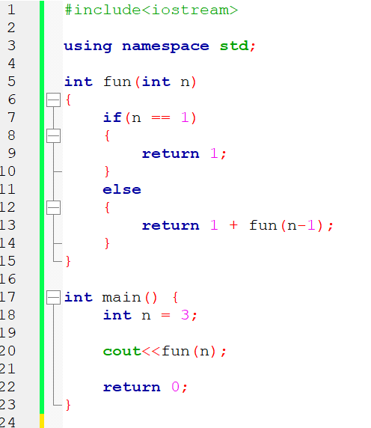
Recursion
fun(3)
return 1 + fun (2)
return 1 + fun (1)
return 1

Slide 4

Recursion
fun(3)
return 1 + fun (2)
return 1 + fun (1)
return 1

Slide 5
Recursion
fun(3)
return 1 + fun (2)
return 1 + 1
return 1

Slide 6

Recursion
fun(3)
return 1 + fun (2)
return 2

Slide 7
Recursion
fun(3)
return 1 + 2
return 2

Slide 8
Recursion
fun(3)
return 3

Slide 9
Recursion
fun(3)
return 3

Slide 10
Recursion
3
return 3

Slide 11
Recursion
3

Slide 12
Recursion
5! = 5 * 4 * 3 * 2 * 1
4! = 4 * 3 * 2 * 1
3! = 3 * 2 * 1
2! = 2 * 1
1! = 1
0! = 1
5! = 5 * 4!
4! = 4 * 3!
3! = 3 * 2!
2! = 2 * 1!
1! = 1
n! = n* (n-1)!
factorial(n)= n* factorial(n-1)

Slide 13
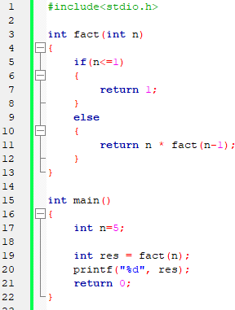
Recursion
fact(5)
return 5 * fact(4)
return 4 * fact(3)
return 3 * fact(2)
return 2 * fact(1)
return 1

Slide 14

Recursion
fact(5)
return 5 * fact(4)
return 4 * fact(3)
return 3 * fact(2)
return 2 * fact(1)
return 1

Slide 15
Recursion
fact(5)
return 5 * fact(4)
return 4 * fact(3)
return 3 * fact(2)
return 2 * 1
return 1

Slide 16
Recursion
fact(5)
return 5 * fact(4)
return 4 * fact(3)
return 3 * fact(2)
return 2

Slide 17

Recursion
fact(5)
return 5 * fact(4)
return 4 * fact(3)
return 3 * fact(2)
return 2

Slide 18
Recursion
fact(5)
return 5 * fact(4)
return 4 * fact(3)
return 3 * 2
return 2

Slide 19
Recursion
fact(5)
return 5 * fact(4)
return 4 * fact(3)
return 6

Slide 20
Recursion
fact(5)
return 5 * fact(4)
return 4 * fact(3)
return 6

Slide 21
Recursion
fact(5)
return 5 * fact(4)
return 4 * 6
return 6

Slide 22
Recursion
fact(5)
return 5 * fact(4)
return 24

Slide 23

Recursion
fact(5)
return 5 * fact(4)
return 24

Slide 24
Recursion
fact(5)
return 5 * 24
return 24

Slide 25
Recursion
fact(5)
return 120

Slide 26

Recursion
fact(5)
return 120

Slide 27
Recursion
120

Slide 28
Practice Problems
#1: You are given a single integer 𝑛. Your task is to find the sum of all integers from 1 to 𝑛, inclusive. Formally, you need to compute:
𝑆=1+2+3+⋯+𝑛
Input:
3
Output:
6
Input:
5
Output:
10

Slide 29
Practice Problems
#2: You are given a single integer n. Your task is to calculate the sum of the digits of n.
Input:
123
Output:
6
Input:
987654321
Output:
45

Slide 30
Practice Problems
#3: You are given a single integer n. Your task is to determine the number of digits in n.
Input:
123
Output:
3
Input:
987654321
Output:
9

Slide 31
Practice Problems
#4: You are given a sentence consisting of lowercase English letters. Your task is to determine whether s is a palindrome. A string is called a palindrome if it reads the same backward as forward. Print "YES" if the string is a palindrome, otherwise print "NO".
Input:
madam
Output:
YES
Input:
hello
Output:
NO

Slide 32
Practice Problems
#4: You are given a sentence consisting of lowercase English letters. Your task is to determine whether s is a palindrome. A string is called a palindrome if it reads the same backward as forward. Print "YES" if the string is a palindrome, otherwise print "NO".
Input:
madam
Output:
YES
Input:
hello
Output:
NO

